Slide 1
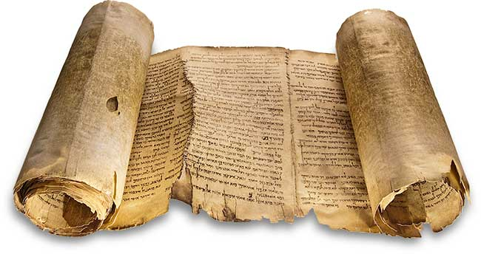
Facsimile of Isaiah A, also known as the Great Isaiah Scroll.
The Dead Sea Scrolls

Slide 2
Assertion: The Bible text as it exists today is an accurate copy of the inspired texts, as they were first written. Sufficient care has been taken to reproduce the texts that our modern copies are fundamentally the same as the original autographs.

Slide 3
Oldest Old Testament Texts (MT)
Cairo Codex – Major & Minor prophets (895 A.D.)
Leningrad Codex of the prophets (916 A.D.)
British Museum Codex (10th or 11th century)
Earliest complete manuscript – Complete Leningrad Codex (1008 A.D.)
Product of the Massoretes (Massoretic Text)

Slide 4
The accuracy of the text was reserved by a group of early Jewish scribes, known as Massoretes. They carried on the tradition of sacred respect for the text, and their efforts were influencial from about 500 A.D to 1000 A.D.
Counted the verses, words and letters of each book
Counted the number of times each letter was used in each book
They noted which verses contained all the letters of the alphabet, calculated the middle verse, the middle word, and the middle letter of each book. (Note: The middle verse of the Pentateuch is Lev. 8:7. The middle verse of the Hebrew Bible is Jeremiah 6:7).
When a copy was made, all of these were checked to ensure the accuracy of the copy. The codices mentioned above are examples of Massoretic effort.

Slide 5
The Dead Sea Scrolls serve as a witness to the accuracy of the Massoretic text which serves as the basis of our translations of the Old Testament.

Slide 6
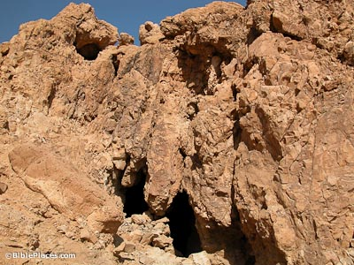
1
Allegedly discovered by a Bedouin shepherd chasing a stray, the initial Dead Sea Scrolls found here changed the study of the Old Testament.
The seven scrolls discovered in this cave were the Manual of Discipline, War of Sons of Light, Thanksgiving Scroll, Isaiah A and B, Genesis Apocryphon and Habakkuk Commentary.

Slide 7
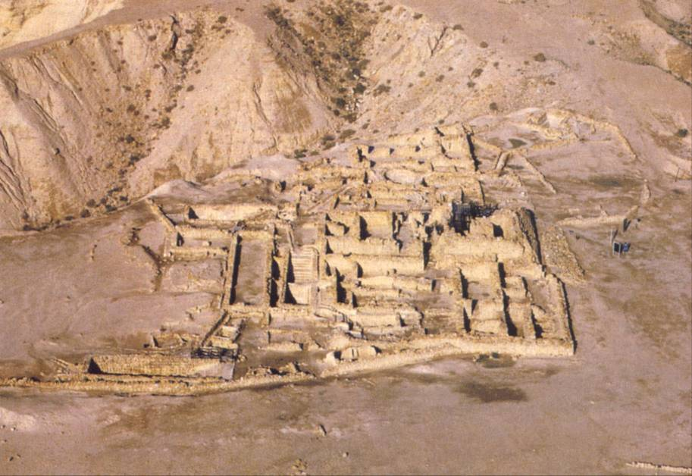
Aerial view of Qumran, home of a group of Essenes (Ascetic Jewish sect). The Essenes stored (perhaps for safekeeping) thousands of scrolls in clay jars in the caves near their community in the hills of the Judean wilderness.

Slide 8
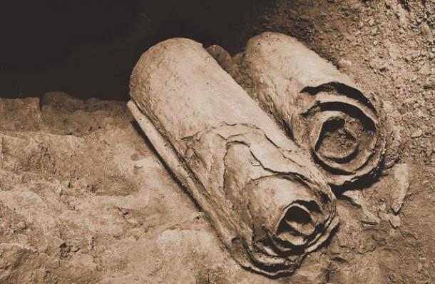
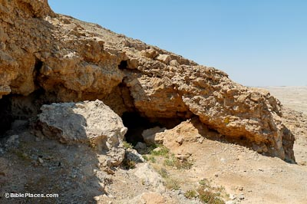
3
The Copper Scroll was found in this cave in 1952. This was the only scroll photographed in situ.
The Copper Scroll is on display in the Amman Museum and lists 63 treasures hidden in the Judean wilderness and Jerusalem area.

Slide 9
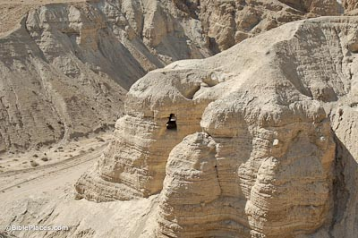
4
This most famous of the Dead Sea Scroll caves is also the most significant in terms of finds. More than 15,000 fragments from over 200 books were found in this cave, nearly all by Bedouin thieves. 122 biblical scrolls (or fragments) were found in this cave. From all 11 Qumran caves, every Old Testament book is represented except Esther. No New Testament books or fragments have been found.

Slide 10
Facsimile of Isaiah A, also known as the Great Isaiah Scroll.

Slide 11
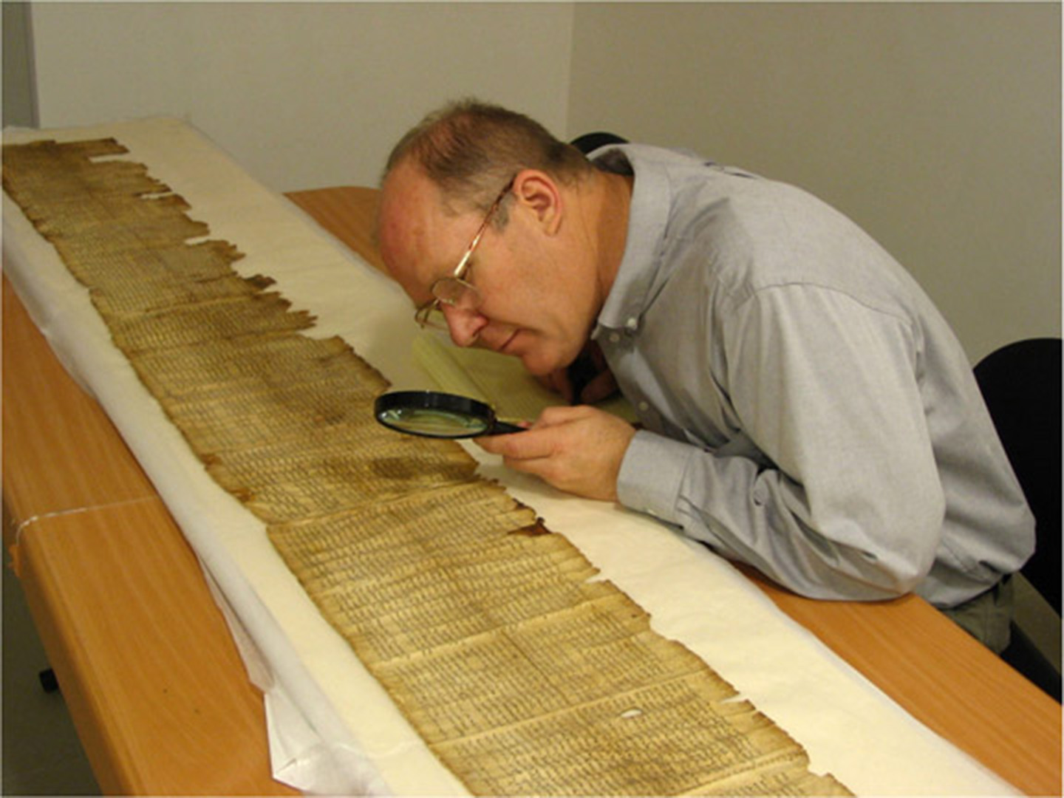
Donald W. Parry (BYU professor), shown here with an Isaiah scroll.

Slide 12
The Isaiah rolls confirm that the Massoretic text is almost identical to the Hebrew text of 1000 years previous. F.F. Bruce: “The new evidence confirms what we had already good reason to believe – that the Jewish scribes of the early Christian centuries copied and recopied the text of the Hebrew Bible with the utmost fidelity” (Second Thoughts on the Dead Sea Scrolls, pp. 61-62). Consider: The RSV (1952) was completed without input from the Dead Sea scrolls. With the rolls in hand, the translation committee determined to revise the translation for accuracy. Adopted only 13 variant readings. In RSV, if you come across the footnote: “One ancient MS”, that refers to Isaiah A of the Dead Sea Scrolls.

Slide 13
An example: Isaiah 21:8 (KJV) “And he cried, A lion: My lord, I stand continually upon the watchtower in the daytime, and I am set in my ward whole nights” (RSV) “Then he who saw cried: “Upon a watchtower I stand, O Lord, continually by day, and at my post I am stationed whole nights. The Hebrew words translated “a lion” and “he who saw” obviously mean two very different things, but are similar in appearance. It is probable an inscription mistake was made. (Most examples like this are caught by a simple consideration of context). Here it seems probable that the RSV (based on Isaiah A) is more accurate.

Slide 14
Summary “Our oldest Hebrew manuscripts date no farther back than the ninth century. This might prove to be a difficult barrier for the Old Testament text were it not for the safeguards devised and followed by the Massoretes and the strict rules observed by earlier Jewish scribes. Early versions of the Old Testament and other sources are of great value since they attest to the reliability of our present text. The Biblical documents of the Dead Sea Scrolls are nothing short of sensational. The most important are the two Isaiah scrolls which, although they exhibit many minor differences, confirm beyond doubt the accuracy of our present Hebrew text. (How We Got the Bible, Neil Lightfoot, page 79)

Slide 15
Important Note: Jesus and the apostles trusted in, and quoted from the Septuagint translation, which was a Greek translation of the Hebrew Scriptures. Obviously, our Lord was comfortable with the text of the Hebrew Scriptures that existed at that time, and we have supplied evidence that from that point until now the text has remained accurate. We can have confidence in the accuracy of the Old Testament Hebrew Scriptures.

